Slide 1
Multi-agent pathfinding in Warehouse Automation
Phillip Wong
Supervised by:
Daniel Harabor & Pierre Le Bodic
Notes:
Morning / Afternoon ~ Name - Phillip Wong ~ Proj: MAPF ~ Along with 2, Dan, Pierre

Slide 2
Overview
Warehouse Automation
01
What is MAPF
02
Contributions
03
What is next
04

Slide 3
Warehouse Automation
Kiva Systems
Peter Wurman
Automating the movement of inventory around the warehouse
Large scale - up to 1000 robots in a warehouse
Robots delivering inventory
Drive Units, Picking stations, Storage pods
Kiva Systems AKA Amazon Robotics

Slide 4
Benefits
Return on investment 1-3 years
Setup time of 4-9 months
Installation of only 3 days
No hard infrastructure (easy to upgrade)
https://www.youtube.com/watch?v=lT4X3cuIHK8&t=161s

Slide 5
Warehouse Automation
Source: https://www.youtube.com/watch?v=8gy5tYVR-28

Slide 6
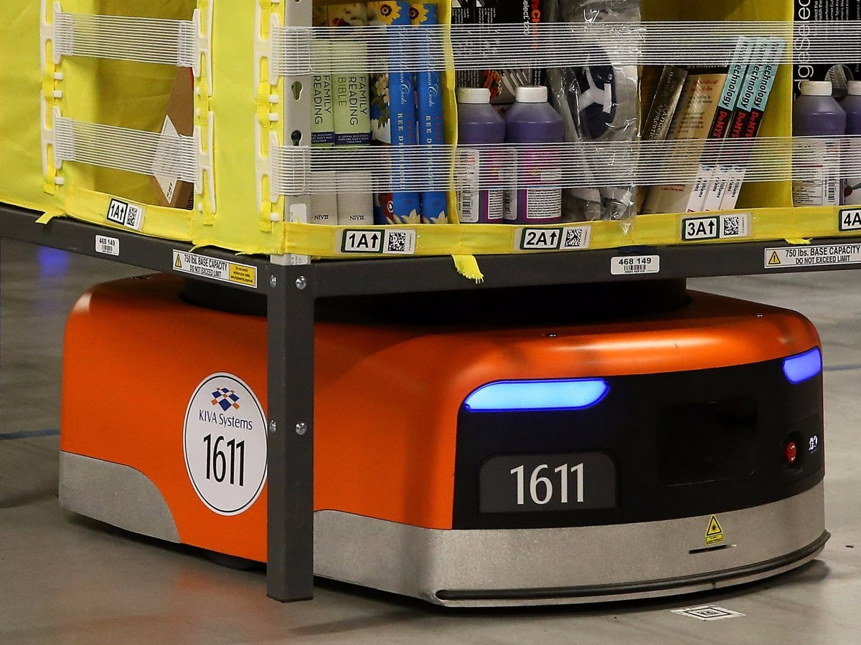
Warehouse Automation
Source: https://www.businessinsider.com.au/amazon-doubled-the-number-of-kiva-robots-2015-10?r=US&IR=T

Slide 7
Simulation

Slide 8
Map with n grids
K agents

Slide 9
Process
Receive Order
Assign Drive Unit
Unit brings order to picking station
Human worker packs the order

Slide 10
Outline
Multiagent
State of the art
Our contributions

Slide 11
What is Multi-agent pathfinding?
Multiple agents moving to goal locations
For each agent find a conflict-free path to the goal
A tile can only have 1 agent at any time

Slide 12
Complexity
State space grows
Number of agents (a)
Size of grid map (t)
Branching factor 5k (up / down / left / right / wait)
Number of path-conflicts (c)?
a * t * d

Slide 13
Specifics of MAPF
Warehouse Automation
Grid-based map (no diagonal movement)
Optimality
Make span
Sum of cost
Down-time
Cooperative multi-agent pathfinding

Slide 14
Solving MAPF
Optimal
Suboptimal
arsarsa
Bounded-suboptimal

Slide 15
Why optimality?

Slide 16
Resolving Conflicts
Search
Find a path for each agent
Conflicts
Identify conflicts between paths
Replanning
Perform search again, reduce the number of conflicts

Slide 17
Areas to improve
Search
Heuristics
Reducing search space
Conflicts
Trivial?
Replanning
Precomputing

Slide 18
Current progress
Warehouse Simulation
Picking station
Drive Units
Order assignment
Single agent pathfinding (A*)
Learning Integer Programming

Slide 19
Contributions
Single agent pathfinding
Linear Programming
Branch and price
Jump Point Search
Compressed Path Databases

Slide 20
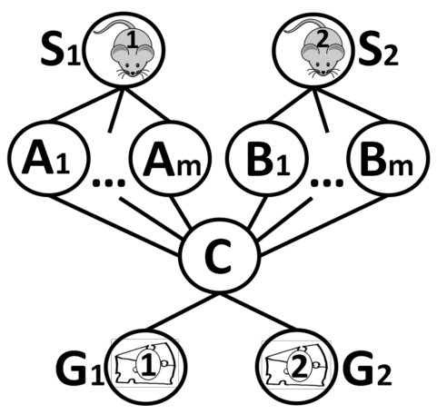
Our focus
State of the art: Conflict Based Search (CBS)

Slide 21
Branch and price

Slide 22
Expected outcomes?

